Slide 1
2024
Investor Conference
Solid State System (3S)
鑫創科技：3259
2024/12/17

Slide 2
Agenda
Company Introduction
Business Overview
Q&A

Slide 3
Safe Harbor Statement
Except for historical information contained herein, the matters set forth in this presentation are forward looking statements that are subject to risks and uncertainties that could cause actual results to differ materially, including the impact of competitive products and pricing, timely design acceptance by our customers, timely introduction of new technologies, ability to ramp new products into volume, industry wide shifts in supply and demand for semiconductor products, industry overcapacity, availability of manufacturing capacity, financial stability in end markets, and other risks.

Slide 4
Agenda
Company Introduction
Business Overview
Q&A

Slide 5
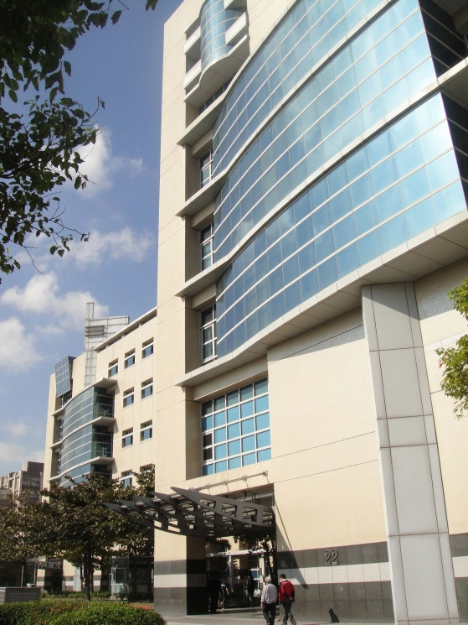
公司介紹
Company Name : Solid State System Co., Ltd.
Establish : Nov. 1998
Chairman : Jeffrey Lin
IPO Date : Dec. 2007 (TPEX: 3259)
Headquarters : Tai Yuen Hi-Tech Industrial Park,
Hsinchu, Taiwan
Other Offices : Shenzhen China
Employees : 110

Slide 6
3S Product Lines
ASIC - NAND Controller (since 1999)
  A veteran in NAND controller market with Key partners: Kioxia & Kingston
  SONOS NVM development experience
  CompactFlash, MMC, xD, SD, USB, eMMC Controllers and SSD solutions…
ASIC - USB Audio Controller (since 2009)
  A veteran in Plug-and-Play Stereo USB Audio Headset market
MEMS - Microphone & Sensor (since 2010)
  Own Chips: In-house designed/patented MEMS sensor & pre-amp ASIC
  Aiming Automotive and high end acoustic pick-up market
Memory Controller (starting 2024~)
  Target Premium value products (HBM & Ultra High Band Width Memory)
  Comprehensive Design team led by DRAM design & Flash Controller design veterans
NAND Flash
Controller
Asia 1st
Manage
NAND Flash Bits
Turn-Key Solutions
WW 1st
Manage
DRAM by Bit
DRAM Controller

Slide 7
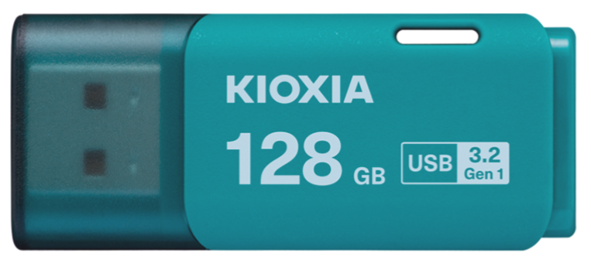
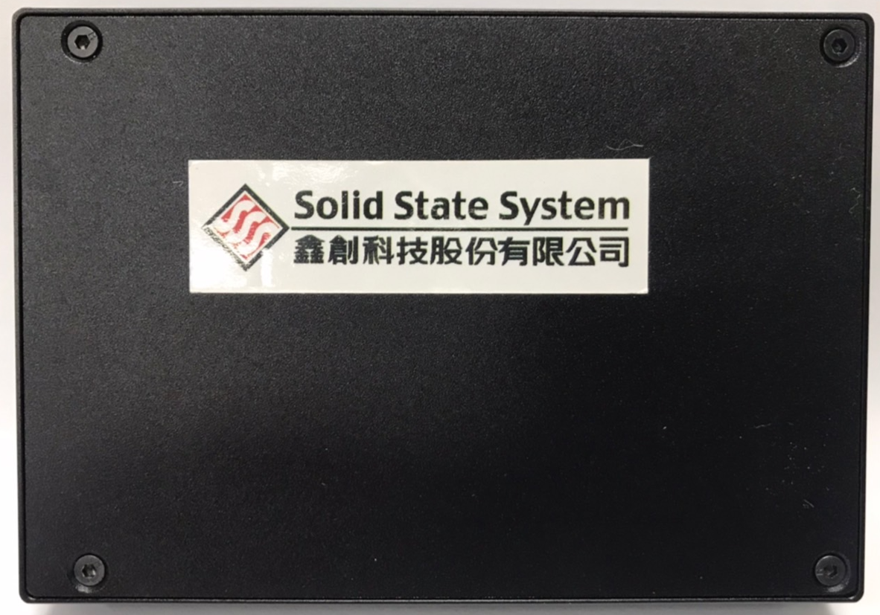
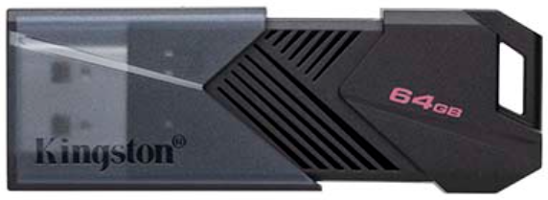
NAND Flash Application Expert
USB 3.2 Gen I Ctr. IC & SSD Total Solution

Slide 8
3S Advantages for NAND Flash Controller
26-year experience and record in delivering NAND flash controller turn-key solution from SLC, MLC, TLC to 3D NAND TLC, QLC.
NAND flash knowhow in-depth. The only one NAND controller maker who had developed NAND interface SONOS cell flash memory.
Broad expertise from device to system solution.

Slide 9
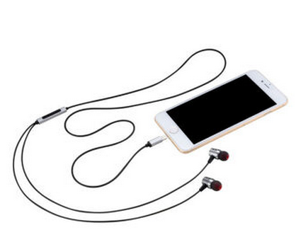
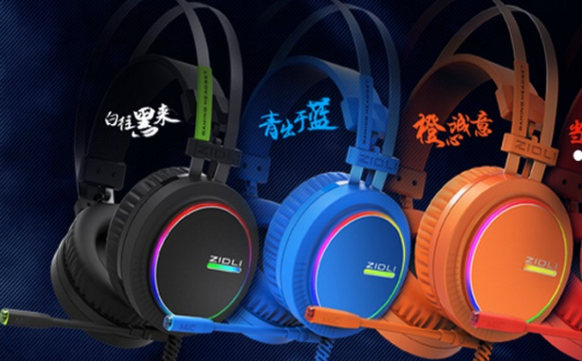
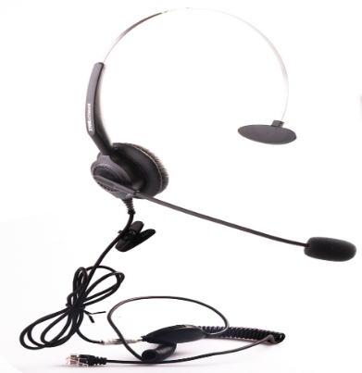

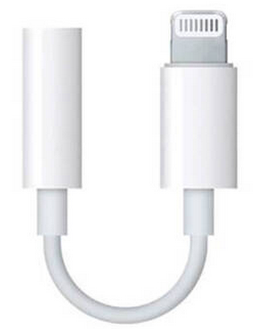
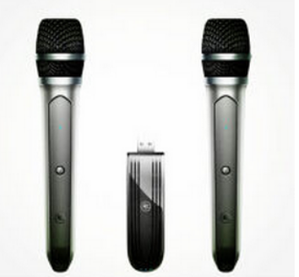
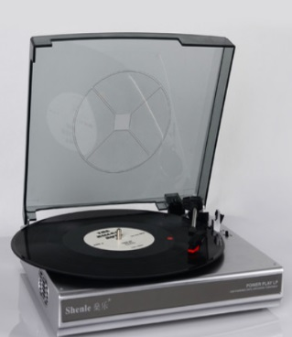
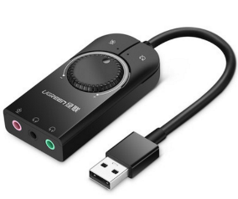
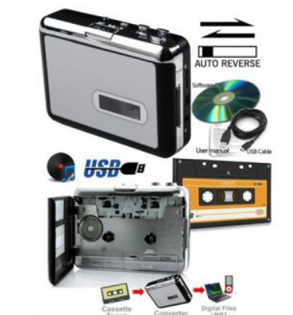
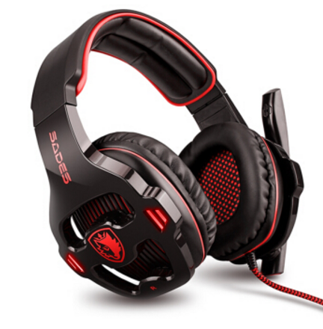
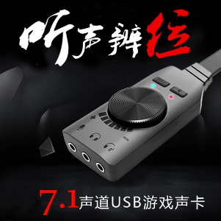
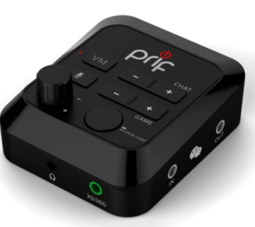
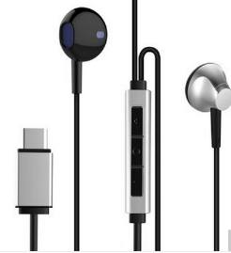
USB AUDIO IC
Product Type with USB AUDIO IC

Slide 10
3S Advantages for USB Audio Controller
  15-year experience and record in delivering USB Audio Controller.
  Audio knowhow in-depth with Application Software Support.
  Dedicated FAE at Shenzhen Office for Quick Customer Support.

Slide 11
MEMS Mic Product Features
MEMS Mic R&D Team
Reasonable allocation of resources
Sensor
R&D Dept.
Cooperate to solve technical issues
ASIC
R&D Dept.
Packaging
Technology
Dept.
Comprehensive consideration of goals and limitations
R&D Strength: Having over 30 years of experience, we possess a comprehensive development team in chip and packaging technologies. Proficient in MEMS structures, mixed-signal circuits, and acoustic properties, we continuously innovate to create higher-spec products.
Own Chips: Self designed and taped out of MEMS sensor & pre-amp ASIC.
Application-oriented: Developing different application’s MEMS sensors and ASIC base on chip portfolio to meet various requirements.
100% Testing: In-house developed testers with high accuracy trimming process to make sure product consistency.
Patent Protection : Patents cover from chip, packaging to testing of MEMS microphone technology.
Supporting: FAE team provides professional on-site support from design stage to production stage worldwide.

Slide 12

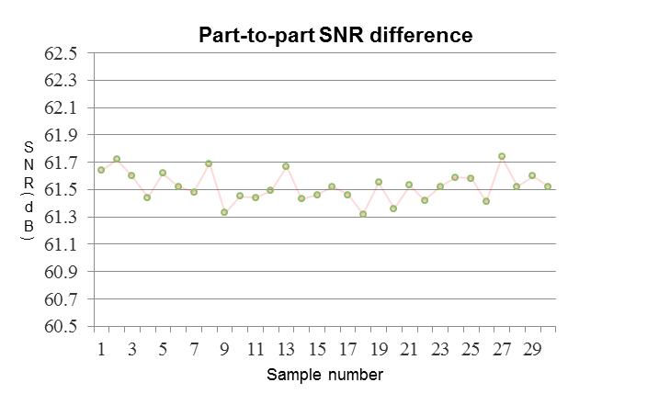
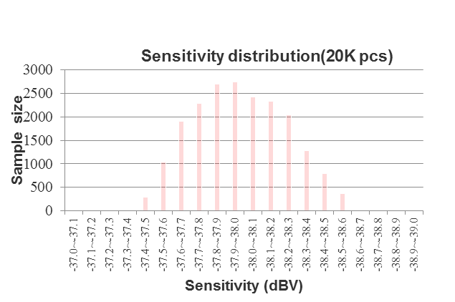
All Series MEMS Microphone Provider – 3S
A Complete MEMS Mic R&D Team
High Product Consistency
Sensor
R&D Dept.
Reasonable allocation of resources
Cooperate to solve technical issues
ASIC
R&D Dept.
Packaging
Technology
Dept.
Tolerance
~±0.25 dB
Comprehensive consideration of goals and limitations

Slide 13
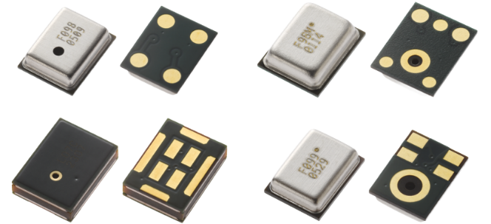
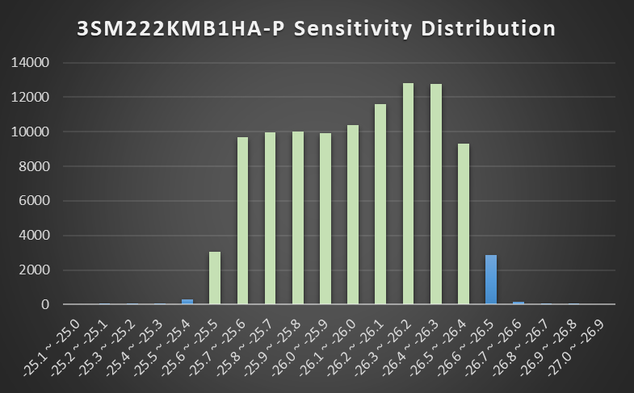
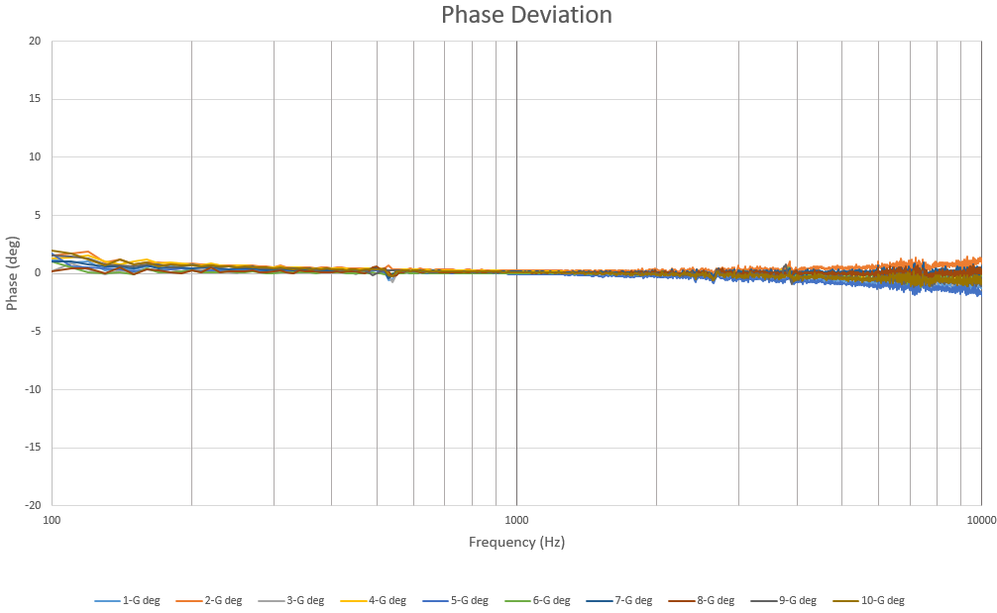
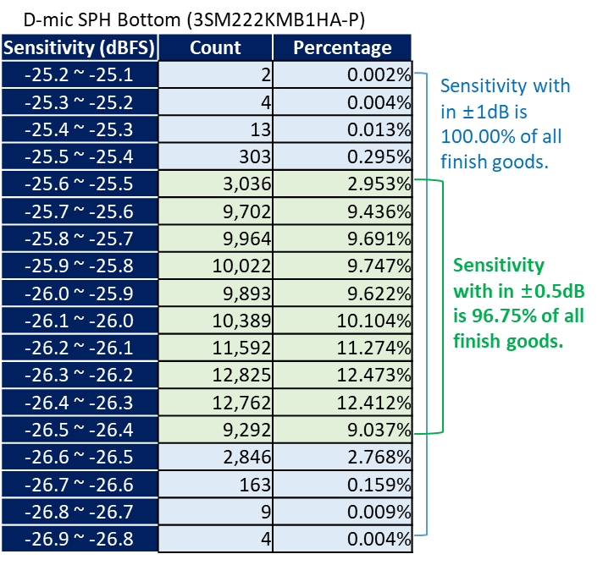
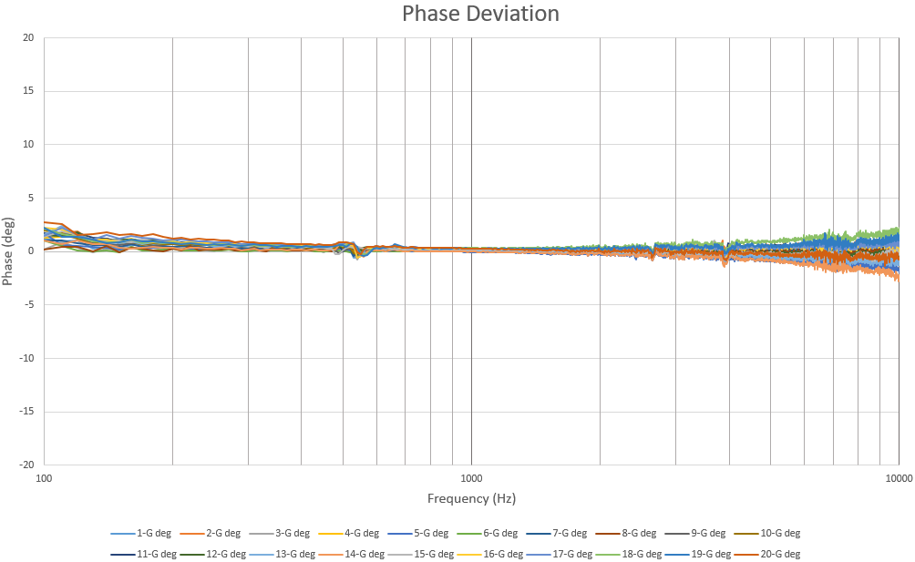
3S MEMS Mic High Consistency
High Sensitivity Consistency±1dB
High Phase Consistency
1-lot Phase Deviation
D-mic SPH Bottom (3SM222KMB1HA-P)
Sample Size
Sample | Frequency (Hz)
 | 100 | 200 | 300 | 500 | 700 | 1000 | 2000 | 3000 | 4000 | 5000 | 6000 | 7000 | 8000 | 9000 | 10000
MAX-MIN | 1.76 | 0.61 | 0.55 | 0.62 | 0.31 | 0.32 | 0.63 | 0.90 | 0.96 | 1.36 | 1.66 | 2.06 | 2.12 | 2.18 | 2.98
Max phase difference within 3° for the same lot
Using wafers from the same lot can further optimize phase consistency.
Sensitivity(dBFS)
Lot 1 : L29M H005
Sen Distribution (≈100Kpcs)
2-lot Phase Deviation
Sample | Frequency (Hz)
 | 100 | 200 | 300 | 500 | 700 | 1000 | 2000 | 3000 | 4000 | 5000 | 6000 | 7000 | 8000 | 9000 | 10000
MAX-MIN | 2.60 | 1.01 | 0.87 | 0.83 | 0.42 | 0.37 | 0.74 | 1.12 | 1.33 | 1.81 | 2.57 | 2.69 | 2.83 | 3.35 | 4.23
The maximum phase difference between different lots is within 5°
Lot 1 : L29M H005
Lot 2 : L28L H003

Slide 14
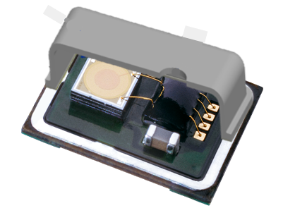
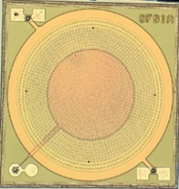
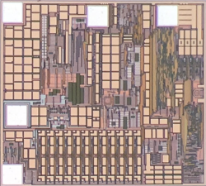
All Series MEMS Microphone Provider – 3S
SENSOR
ASIC
Sensor Types
ASIC Types
Decay Low
Frequency Response
Flat Low
Frequency Response
High SNR
Analog
Single-Ended Interface
Analog
Differential Interface
Product diversity
Features
meet applications
High Resistant Sudden Pressure
Anti-light Interference
Low SNR
Digital
PDM Interface
Analog
Single-Ended Interface
Capacitor Filter

Slide 15
MEMS-High Spec Product Progress
Series | Product
Analog MEMS Microphone | SPM 3729 Bottom Port SNR 68dB (2024/Q4 MP)
Differential Interface | SPA 3325 Bottom Port SNR 65dB (2022/Q4 MP)
Digital MEMS Microphone | SPG 4020 Top Port SNR 65dB (2024/Q3 Sample) | SPH 3526 Bottom Port SNR 67dB (2024/Q4 MP)

Slide 16
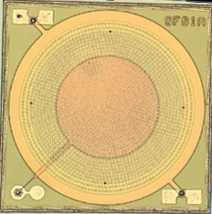
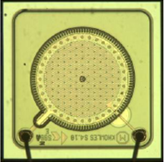
3S Patent Introduction
Package
Other
(ex. Test, Trimming…)
Wafer
Own IP, Own IC, Own Patents
3S MEMS patent differs from Knowles
3S’ patented MEMS structure | Knowles’ patented MEMS structure
US08093119B2 | US06535460B2
More than 100 items
MEMS microphone own patents over the United States, China and Taiwan

Slide 17
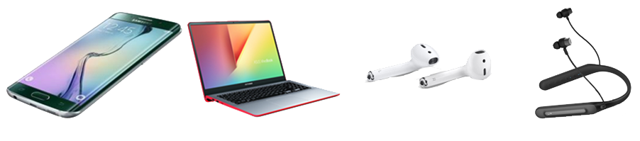
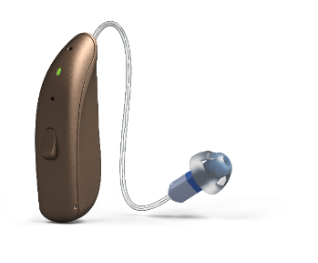
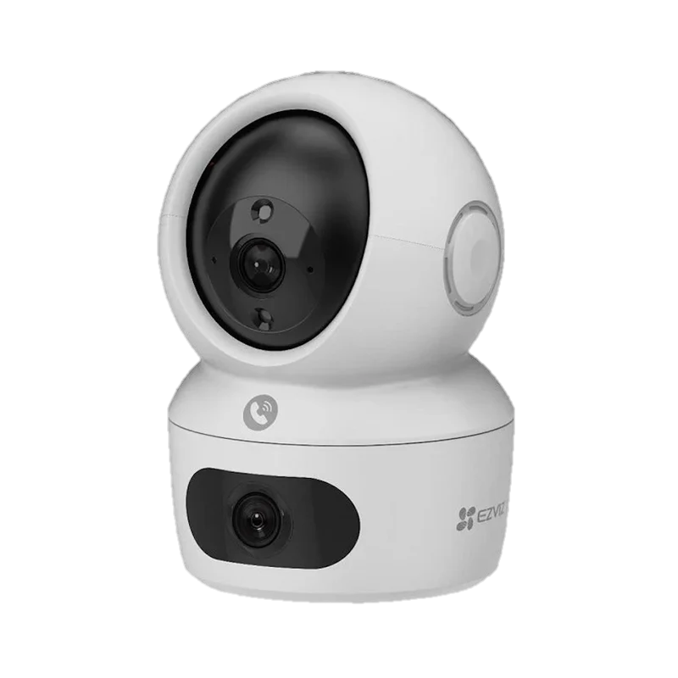
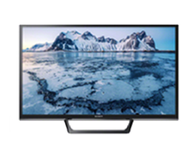
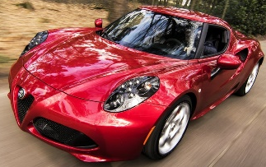
3S Field of Product Application
Mobile Phone
Notebook
Automotive
Mic Array
Audio Conference
Smart Speaker
Smart TV
Smart Home
AI Detection
3S Product Application
Hearing Aids
Headset
Talking
ANC
ENC
Infrasound 5Hz~20Hz
Sound 20Hz~20KHz
Surveillance
Ultrasound 20KHz~90KHz
17

Slide 18




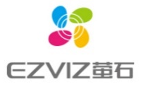






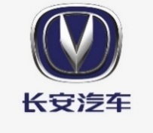
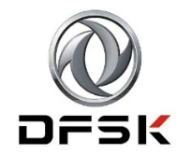






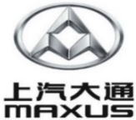



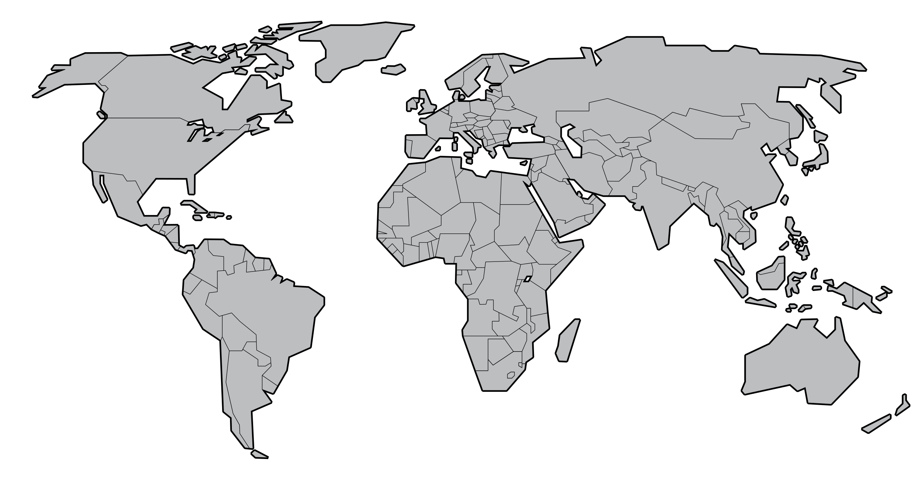























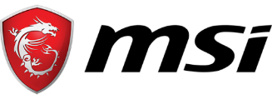
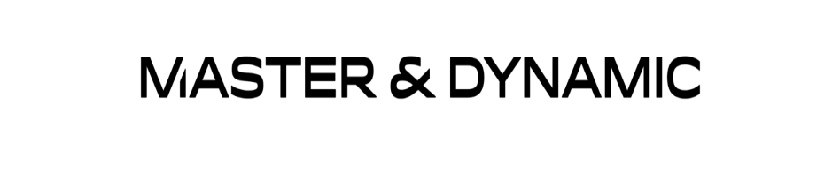



Main Customer
Japan
China
America
Europe
Korea
Taiwan
India
18

Slide 19
Agenda
Company Introduction
Business Overview
Q&A

Slide 20
Consolidated Balance Sheet
NT$K
 | 2021 | 2022 | 2023 | 2024Q3
Current Assets | 596,135 | 518,842 | 451,953 | 345,947
Cash and Cash Equivalents | 171,771 | 65,952 | 141,727 | 97,033
Accounts Receivable | 80,417 | 54,234 | 26,000 | 31,678
Inventory | 334,848 | 390,453 | 268,581 | 199,552
Other Current Assets | 9,099 | 8,203 | 15,645 | 17,684
Non-current Assets | 168,219 | 110,948 | 56,982 | 60,781
Total Assets | 764,354 | 629,790 | 508,935 | 406,728
Total Liabilities | 113,548 | 132,131 | 82,827 | 120,224
Common stock | 746,877 | 746,877 | 569,659 | 569,659
Total Stockholders' Equity | 650,806 | 497,659 | 426,108 | 286,504
Book value per share | 8.71 | 6.66 | 7.48 | 5.03

Slide 21
Consolidated Statements of Comprehensive Income
NT$K
 | 2021 | 2022 | 2023 | 2024Q3
Sales | 692,352 | 402,605 | 275,641 | 166,095
Gross Profit | 229,488 | 116,429 | 15,315 | 6,278
Gross margin(%) | 33 | 29 | 6 | 4
Selling Expenses | 65,500 | 67,713 | 57,140 | 37,492
G&A Expenses | 31,670 | 35,932 | 43,120 | 29,091
R&D Expenses | 135,756 | 133,920 | 123,010 | 84,585
Operating Income | (3,438) | (121,136) | (207,955) | (144,890)
Non-operating Income& Exp. | 4,759 | (5,558) | (13,778) | 5,286
Income Before Tax | 1,321 | (126,694) | (221,733) | (139,604)
Net Income | 1,158 | (156,559) | (220,015) | (139,604)
EPS(NT$) | 0.02 | (3.15) | (4.34) | (2.45)

Slide 22
Revenue by Product

Slide 23
Future Prospect
Continue developing QLC NAND Flash Controller and value-add application solutions.
Expanding high quality MEMS Mic market share and enter high performance oriented main stream market.
Continue developing Audio IC products to secure existing market and customers, and expanding applications.
Develop AI accelerator related high band width memory such as HBM

Slide 24
Agenda
Company Introduction
Business Overview
Q&A

